Slide 1
A Holistic Analysis of Eniac's Discounting
Data Analysts: Hanne Prüfer
Helene Rebelo
Irene da Cruz
Roberto Cavotti
ENIAC
14/12/2023

Slide 2
The discount strategy has a positive impact on the revenue
but distribution on categories and months should be reviewed
ENIAC

Slide 3
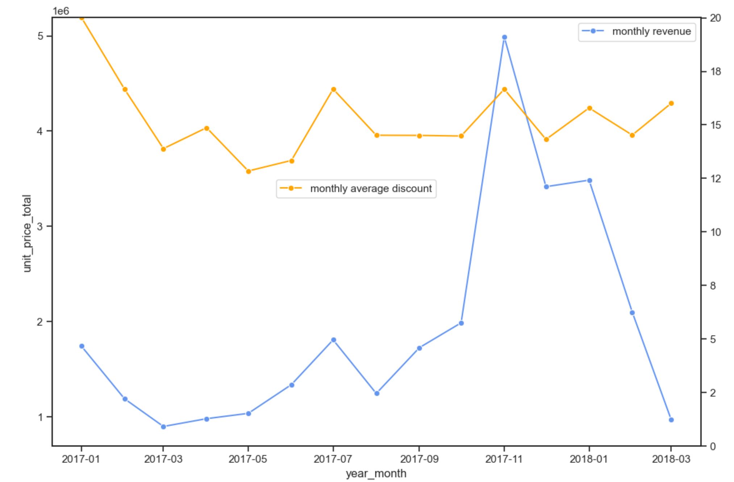
How does monthly revenue and the average discount rate impact on sales performance from 2017 to 2018 ?
unit total price in K
% Average discount
ENIAC
ENIAC
years-month

Slide 4
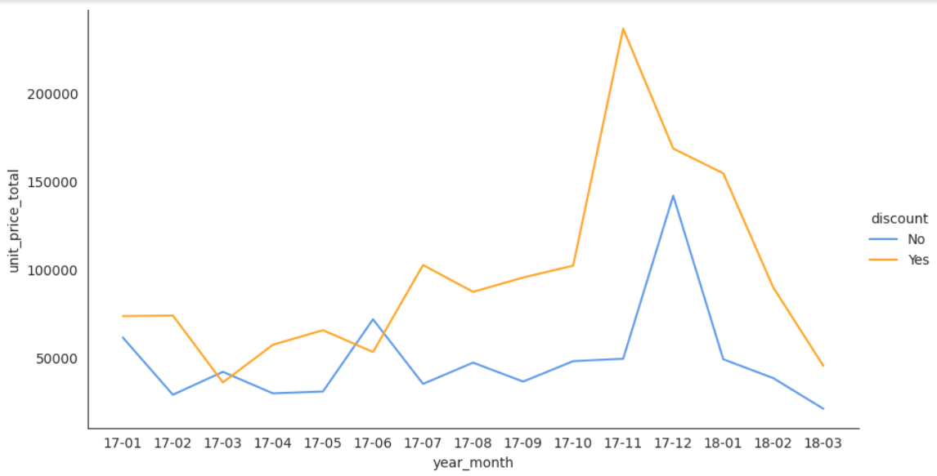
How do discounts influence sales during seasonal shifts and special events?
Black Friday
A sample of 4,090 orders, equally divided between those with and without discounts
Christmas
ENIAC

Slide 5
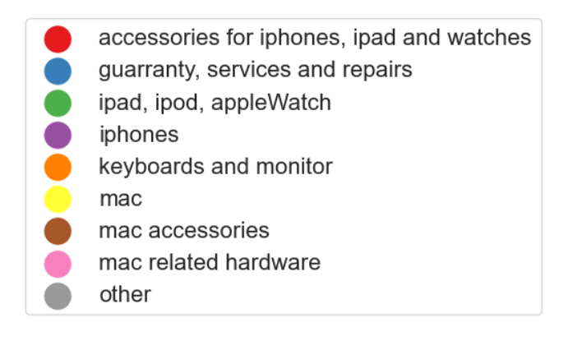
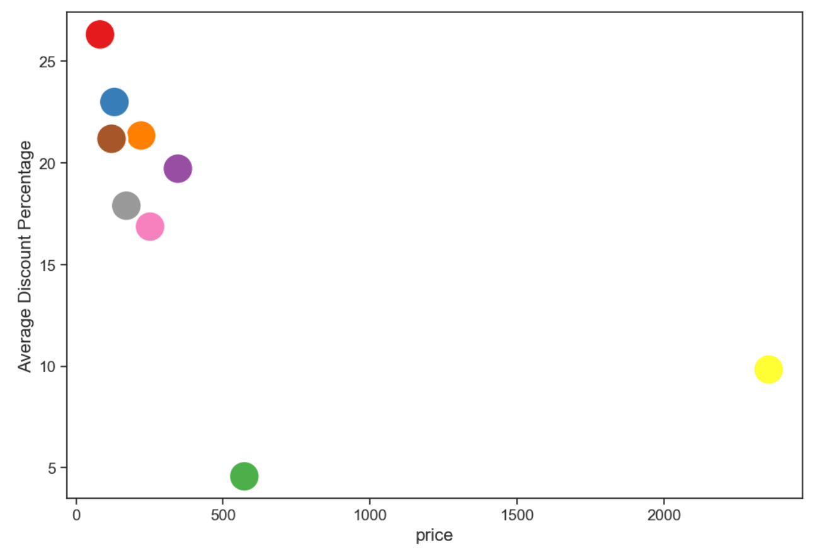
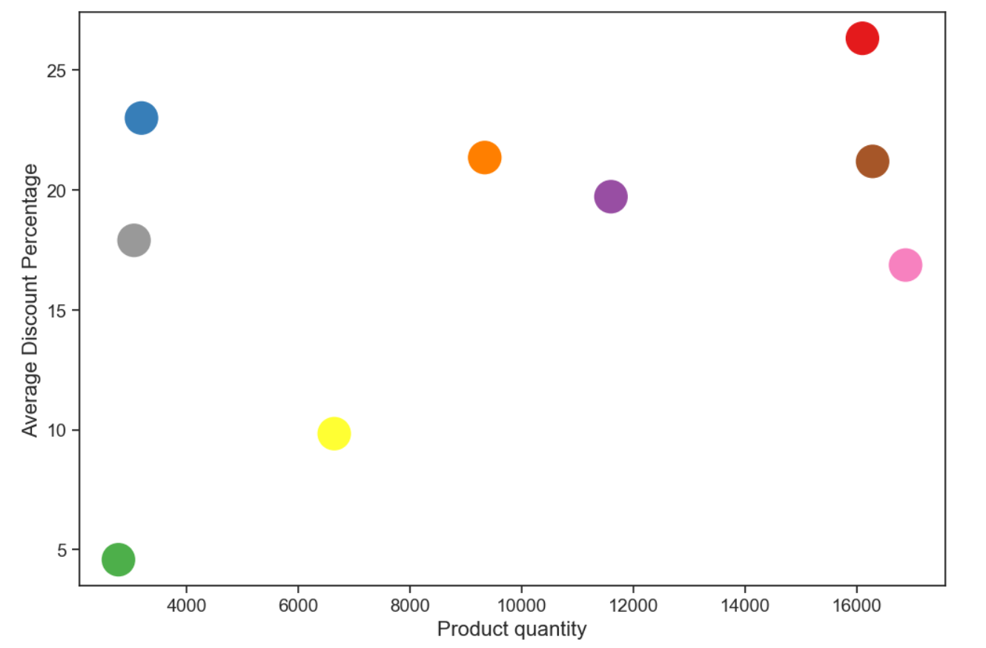
How do discounts vary with the pricing and quantity of different product categories?
Lower price higher discount
Higher the quantity of product, higher the discount
ENIAC

Slide 6
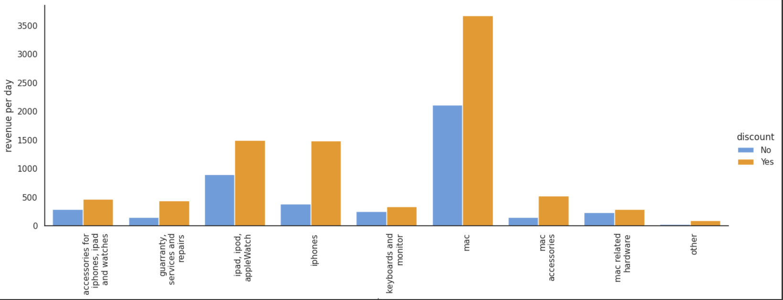
Discounts have an effect on the revenue per day, but depending on category
Sample: 11.982 orders from products that have been sold with and without discount - Jan - Oct 2017
categories with the highest discounts and most sold products
ENIAC

Slide 7
Cleaning the data
Corrupted Database: which affected the overall integrity of the database.
Incongruent Data: Identified inconsistencies, mismatched and/or duplicate data.
Double Dots Numbers: Anomalies in numerical values, duplicated or irregular decimal points.
Data Quality Concerns: Addressing issues affecting the reliability and completeness of the dataset.
ENIAC
ENIAC

Slide 8
How to improve data?
Standardize how to write values in currency
Avoid missing data - blank columns and rows
Include customer data to assess
Include new columns with product costs, delivery values, and taxes to calculate profit
ENIAC
ENIAC

Slide 9

ENIAC
ENIAC

Slide 10
Impact of top products on revenue
100 most sold products (26556)
Low Price Items
the best sellers
more discounts
30% of all orders
22,8% of the total revenue
ENIAC
ENIAC

Slide 11
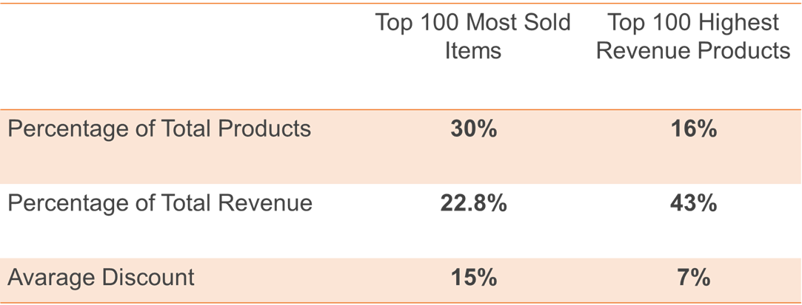
Impact of top products on revenue
Low Price
Higher Prices

